Slide 2





INDEX
COMMUNICATIONS?
TYPES OF NETWORK
How computers communicate?
What is Internet
What are different types of Network
How they help us and A major problem
NETWORKING
TCP VS UDP
What is TCP & uses
What is UDP & uses
BY ROYALHACKERST
&
PARIS
IP ADRESS
What is IP Address
types of IP Address

Slide 3
INDEX
NETWORKING
COMMUNICATION?
COMMUNICATIONS?
TYPES OF NETWORK
How computers communicate?
What is Internet
What are different types of Network
How they help us and A major problem
Computers communicate by sending data in small units called packets over networks using protocols like TCP/IP. Each computer has a unique IP address, and data travels through routers and switches to reach the correct destination. Protocols ensure the data is sent, received, and understood correctly. Communication can happen via wired (like Ethernet) or wireless (like Wi-Fi) connections, and once the data reaches the receiver, it is reassembled into its original form.
TCP VS UDP
What is TCP & uses
What is UDP & uses
BY ROYALHACKERST
&
PARIS
IP ADRESS
What is IP Address
types of IP Address
ENDS

Slide 4
INDEX
COMMUNICATION?
Computers communicate by sending data in small units called packets over networks using protocols like TCP/IP. Each computer has a unique IP address, and data travels through routers and switches to reach the correct destination. Protocols ensure the data is sent, received, and understood correctly. Communication can happen via wired (like Ethernet) or wireless (like Wi-Fi) connections, and once the data reaches the receiver, it is reassembled into its original form.
TYPES OF NETWORK
COMMUNICATIONS?
How computers communicate?
What is Internet
What are different types of Network
How they help us and A major problem
INTERNET
TCP VS UDP
The internet is a global network of interconnected computers and servers that allows for the exchange of data and communication through various protocols, enabling access to websites, services, and information.
What is TCP & uses
What is UDP & uses
IP ADRESS
What is IP Address
types of IP Address
ENDS

Slide 5




TCP
INTERNET
COMMUNICATION?
The internet is a global network of interconnected computers and servers that allows for the exchange of data and communication through various protocols, enabling access to websites, services, and information.
Computers communicate by sending data in small units called packets over networks using protocols like TCP/IP. Each computer has a unique IP address, and data travels through routers and switches to reach the correct destination. Protocols ensure the data is sent, received, and understood correctly. Communication can happen via wired (like Ethernet) or wireless (like Wi-Fi) connections, and once the data reaches the receiver, it is reassembled into its original form.
What is TCP?
TCP (Transmission Control Protocol) is a communication protocol used to ensure reliable data transmission over a network. It breaks data into packets, sends them to the destination, and guarantees that they are received in the correct order and without errors. If any packets are lost or corrupted, TCP requests that they be retransmitted. This ensures a stable and error-free connection between devices.

Slide 6





TCP/IP
Uses of TCP
ENDS
TCP
INTERNET
What is TCP?
TCP (Transmission Control Protocol) is a communication protocol used to ensure reliable data transmission over a network. It breaks data into packets, sends them to the destination, and guarantees that they are received in the correct order and without errors. If any packets are lost or corrupted, TCP requests that they be retransmitted. This ensures a stable and error-free connection between devices.
The internet is a global network of interconnected computers and servers that allows for the exchange of data and communication through various protocols, enabling access to websites, services, and information.

Slide 7



ENDS
UDP
TCP
UDP (User Datagram Protocol) is a communication protocol used for transmitting data over a network. Unlike TCP, UDP does not ensure reliable delivery, ordering, or error-checking. It sends data in "datagrams" and leaves the responsibility of ensuring accuracy to the application. This makes UDP faster and more efficient, especially for real-time applications where speed is critical.
TCP/IP
What is TCP?
Uses of TCP
TCP (Transmission Control Protocol) is a communication protocol used to ensure reliable data transmission over a network. It breaks data into packets, sends them to the destination, and guarantees that they are received in the correct order and without errors. If any packets are lost or corrupted, TCP requests that they be retransmitted. This ensures a stable and error-free connection between devices.

Slide 8
WHAT IS IP
UDP
An IP address (Internet Protocol address) is a unique identifier assigned to each device connected to a network (like the internet). It helps in locating and identifying devices, allowing them to communicate with each other.
UDP (User Datagram Protocol) is a communication protocol used for transmitting data over a network. Unlike TCP, UDP does not ensure reliable delivery, ordering, or error-checking. It sends data in "datagrams" and leaves the responsibility of ensuring accuracy to the application. This makes UDP faster and more efficient, especially for real-time applications where speed is critical.
Types of IPs
IP V4 - format: 32-bit address, written as four octets (e.g., 192.168.1.1).
Range: From 0.0.0.0 to 255.255.255.255.
Total Addresses: Approximately 4.3 billion unique addresses.
Usage: Most commonly used in most networks today but is running out due to the increasing
2. IP V6 - Format: 128-bit address, written as eight groups of four hexadecimal digits .
Range: A much larger address space than IPv4.
Total Addresses: Approximately 340 undecillion (3.4×10^38) addresses, ensuring a virtually | unlimited number of devices.
Usage: Designed to replace IPv4 and address the limitations of IPv4, especially as the number | connected devices grows.
TCP/IP
Uses of TCP

Slide 9


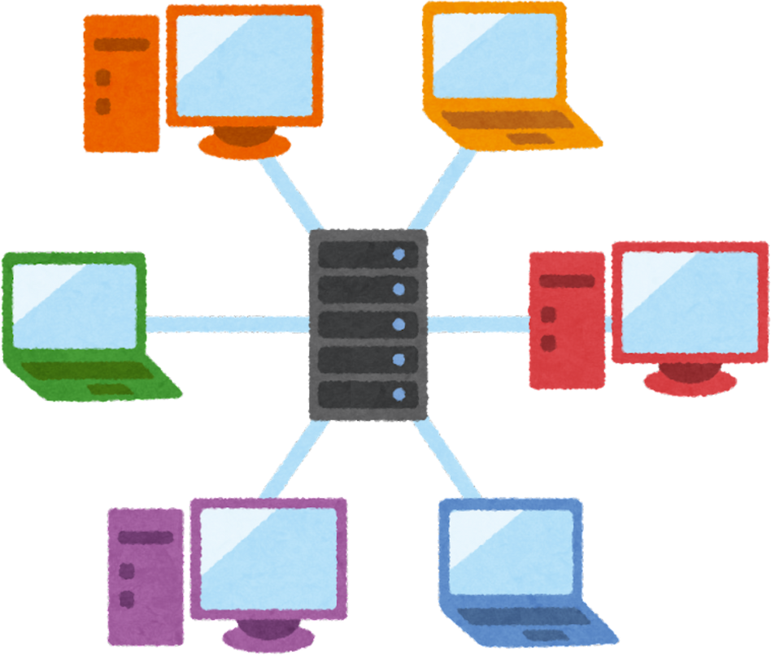

TYPES OF NETWORK
UDP
WHAT IS IP
UDP (User Datagram Protocol) is a communication protocol used for transmitting data over a network. Unlike TCP, UDP does not ensure reliable delivery, ordering, or error-checking. It sends data in "datagrams" and leaves the responsibility of ensuring accuracy to the application. This makes UDP faster and more efficient, especially for real-time applications where speed is critical.
An IP address (Internet Protocol address) is a unique identifier assigned to each device connected to a network (like the internet). It helps in locating and identifying devices, allowing them to communicate with each other.
Types of IPs
IP V4 - format: 32-bit address, written as four octets (e.g., 192.168.1.1).
Range: From 0.0.0.0 to 255.255.255.255.
Total Addresses: Approximately 4.3 billion unique addresses.
Usage: Most commonly used in most networks today but is running out due to the increasing
2. IP V6 - Format: 128-bit address, written as eight groups of four hexadecimal digits .
Range: A much larger address space than IPv4.
Total Addresses: Approximately 340 undecillion (3.4×10^38) addresses, ensuring a virtually | unlimited number of devices.
Usage: Designed to replace IPv4 and address the limitations of IPv4, especially as the number | connected devices grows.

Slide 10
WHAT IS IP
TYPES OF NETWORK
An IP address (Internet Protocol address) is a unique identifier assigned to each device connected to a network (like the internet). It helps in locating and identifying devices, allowing them to communicate with each other.
Types of IPs
IP V4 - format: 32-bit address, written as four octets (e.g., 192.168.1.1).
Range: From 0.0.0.0 to 255.255.255.255.
Total Addresses: Approximately 4.3 billion unique addresses.
Usage: Most commonly used in most networks today but is running out due to the increasing
2. IP V6 - Format: 128-bit address, written as eight groups of four hexadecimal digits .
Range: A much larger address space than IPv4.
Total Addresses: Approximately 340 undecillion (3.4×10^38) addresses, ensuring a virtually | unlimited number of devices.
Usage: Designed to replace IPv4 and address the limitations of IPv4, especially as the number | connected devices grows.
THANK YOU

Slide 11
THANK YOU

